Slide 1


Mobile robot with Ros for education
Major Project BEng Design Engineering 2017/2018
Student : Marlon Gwira
Supervisor : Dr Zhijun Yang

Slide 2
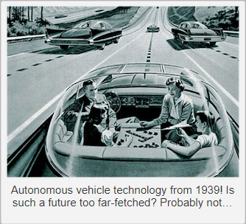
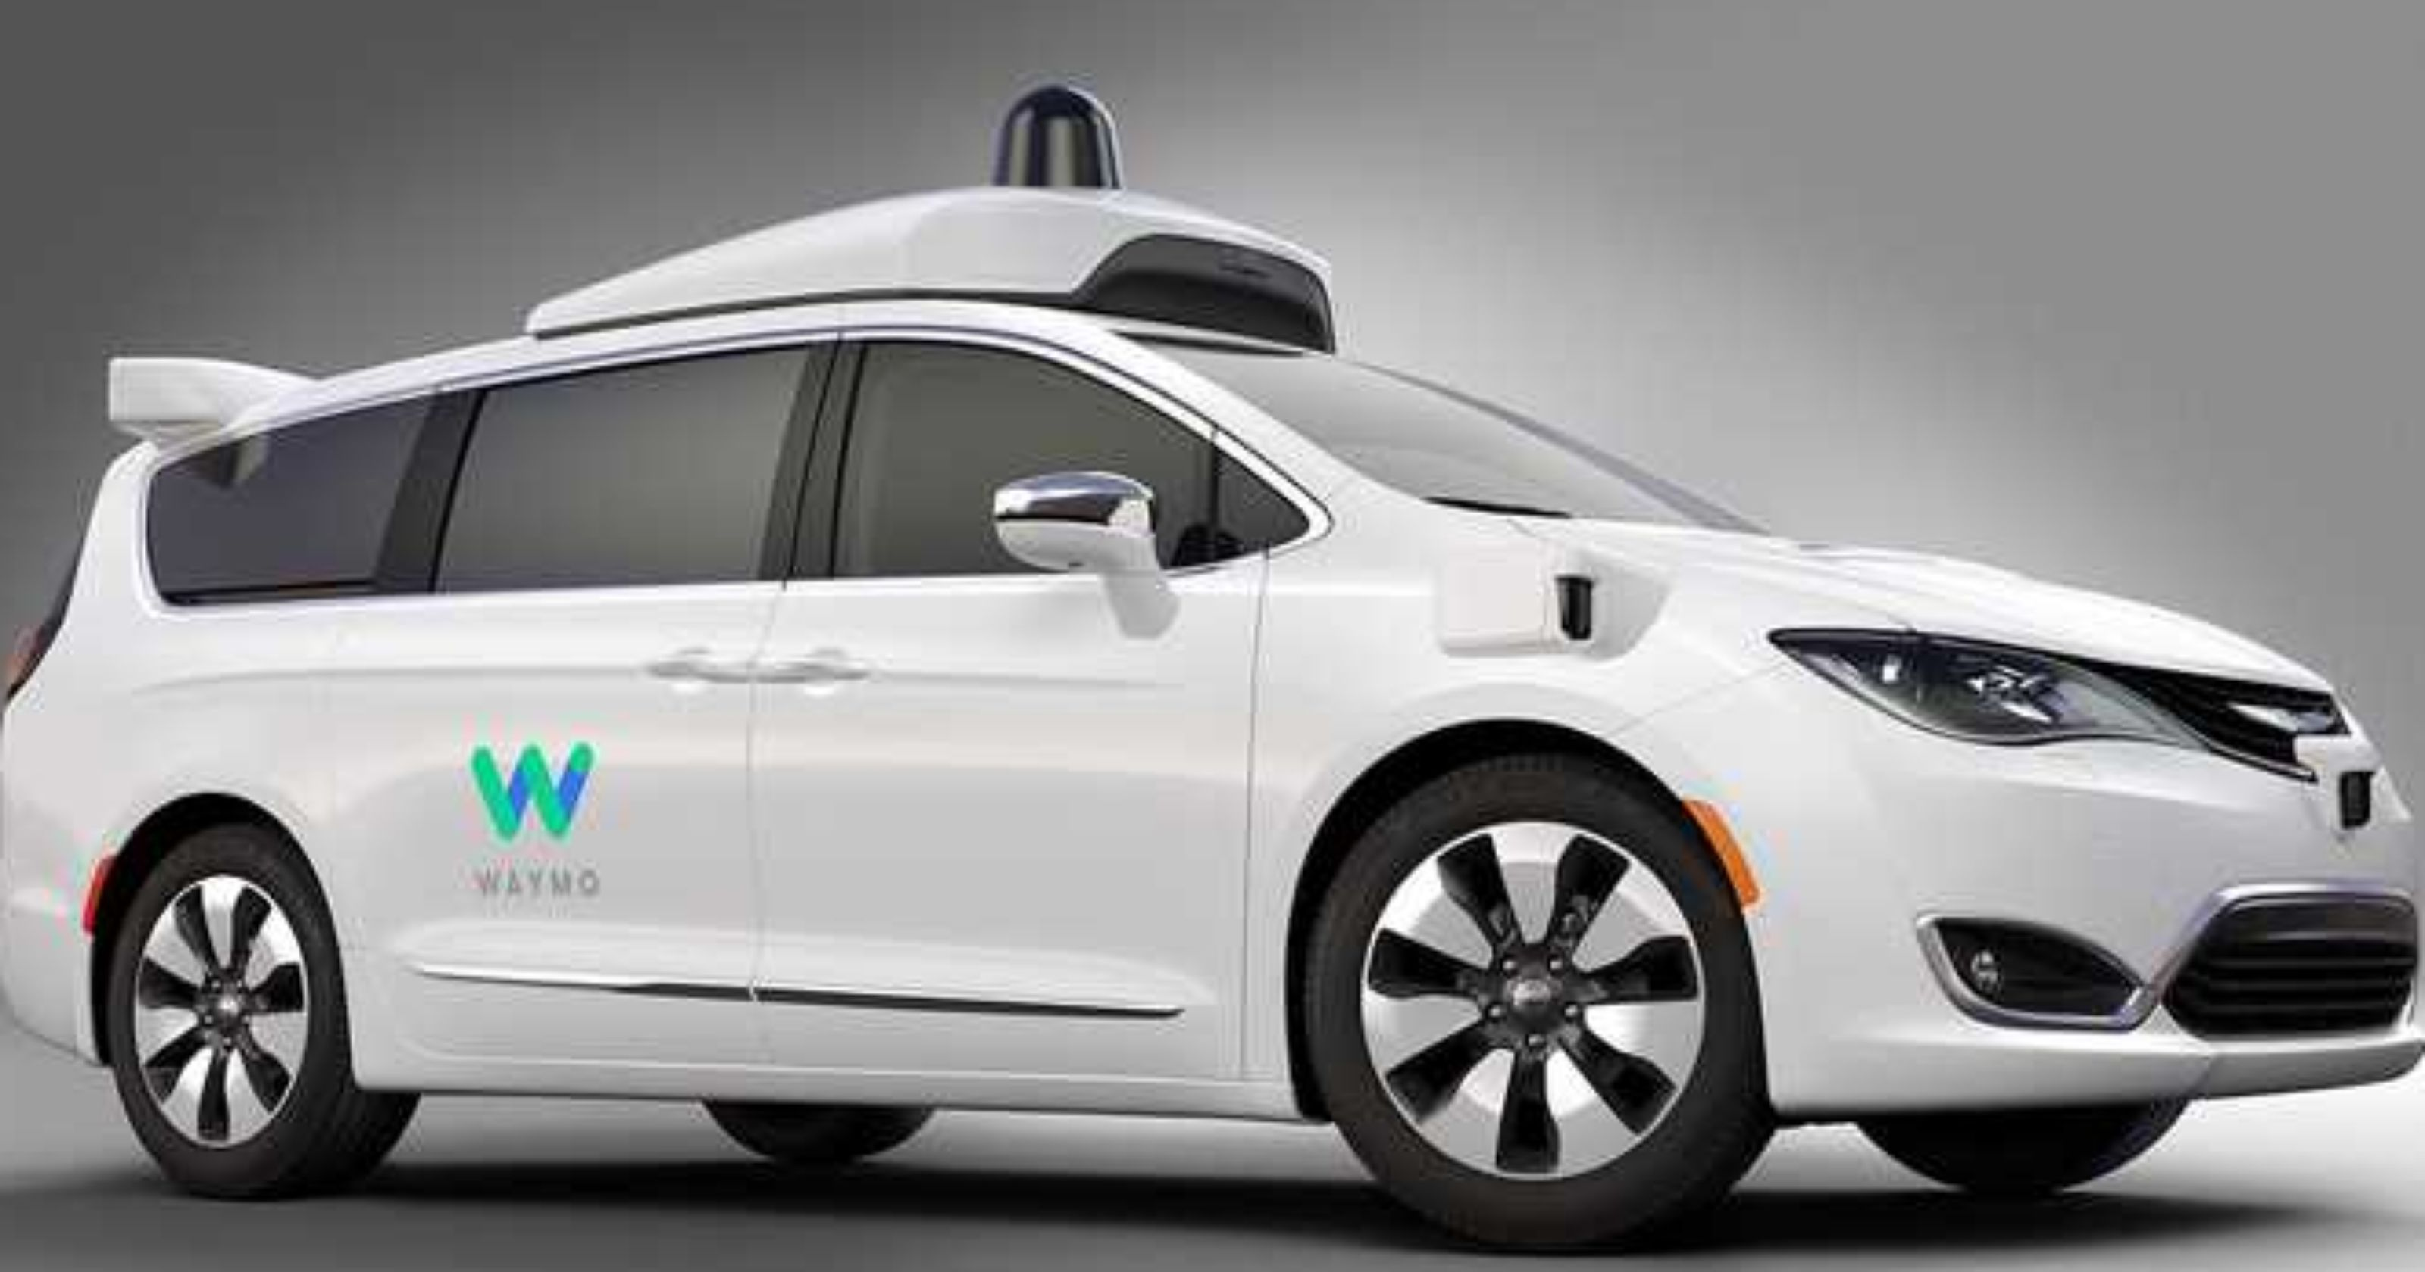
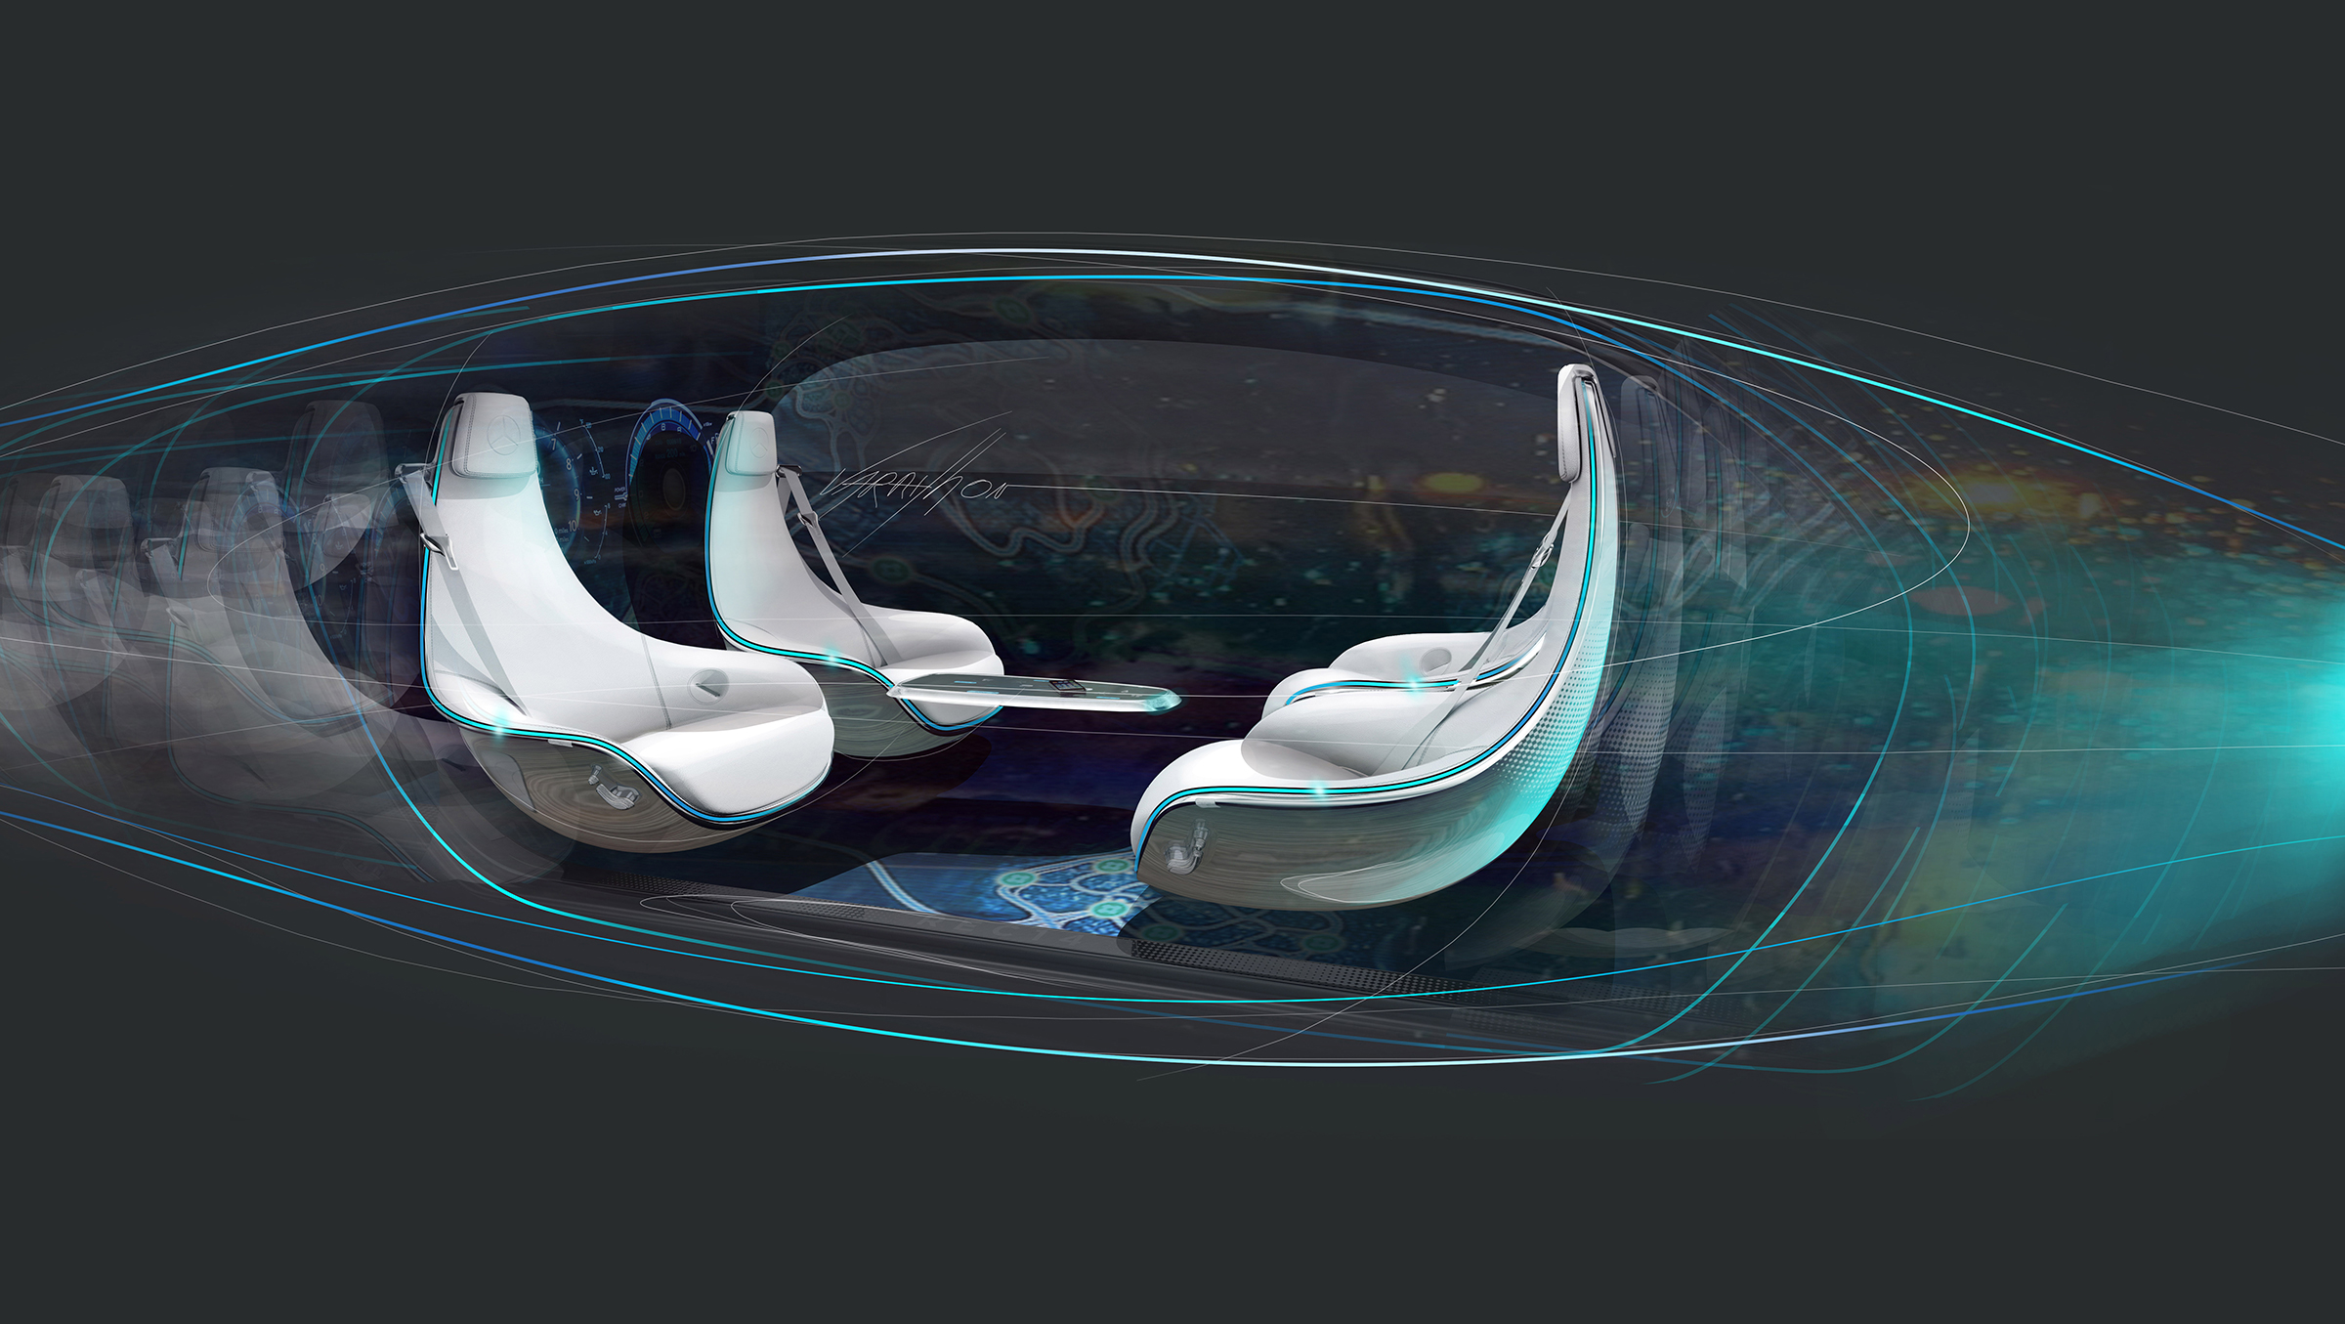
Why I chose this project
Mobile robots represent the future
There is and they will be a lot of demand for people which such expertise
To inspire younger generation as I was inspired
Notes:
In the first point remember to highlight how the tv series inspired you

Slide 3
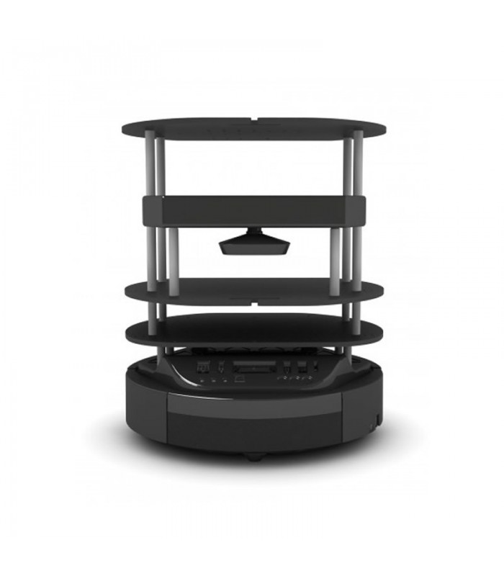
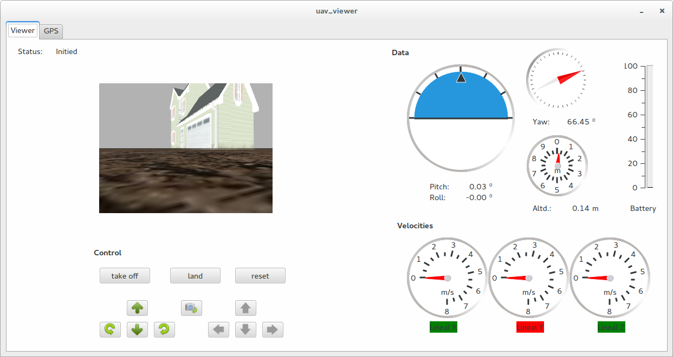
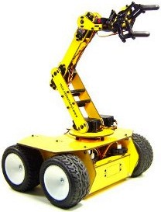
Projects main goals
Mobile robot
User interface
Manipulator
Notes:
Reason for interfacing a manipulator with a mobile robot is to showcase how a pick and place with teleoperation where one of the degree of freedom of the manipulator is the robot itself hence have a more rounder view of the world of robotics.
Building a mobile robot with Ros
Making a user interface to allow understanding of the basic functions of the robot
Interface mobile robot with a robot manipulator

Slide 4
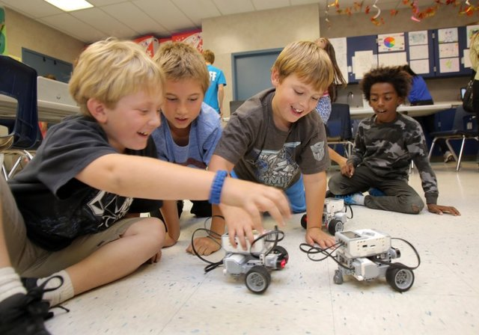
State of the art
What are mobile robots?
About ROS
Teaching Robotics
Notes:
-define what mobile robots are
-talk through the ROS framework
-Highlight the need of teaching robotics

Slide 5
Background information
Where did the project start form..?

Slide 6
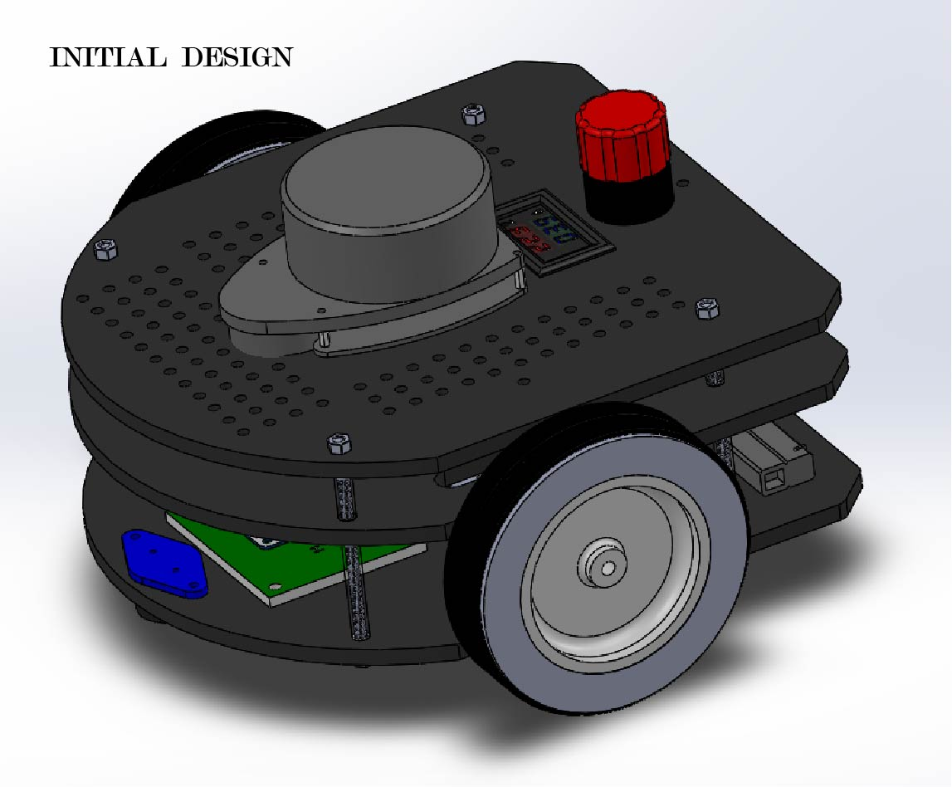
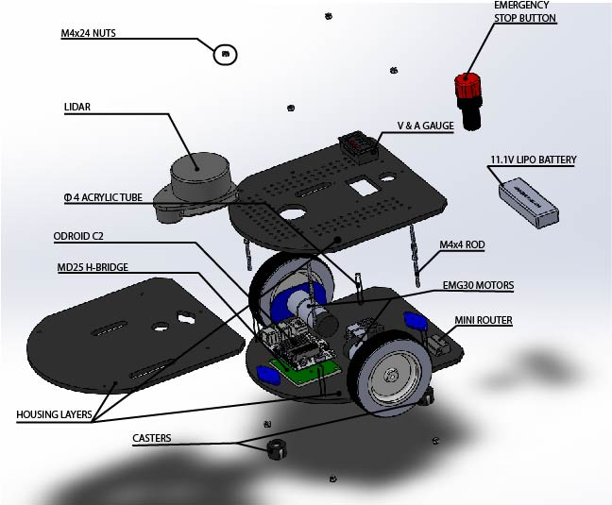

Slide 7
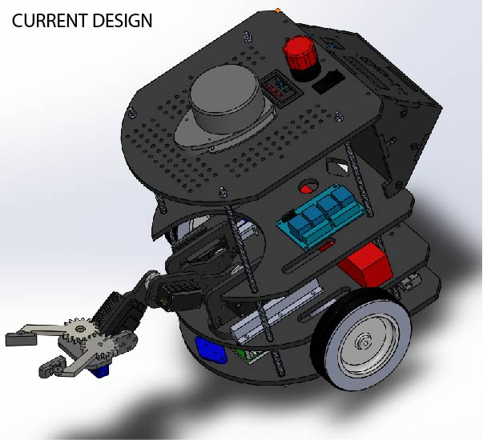
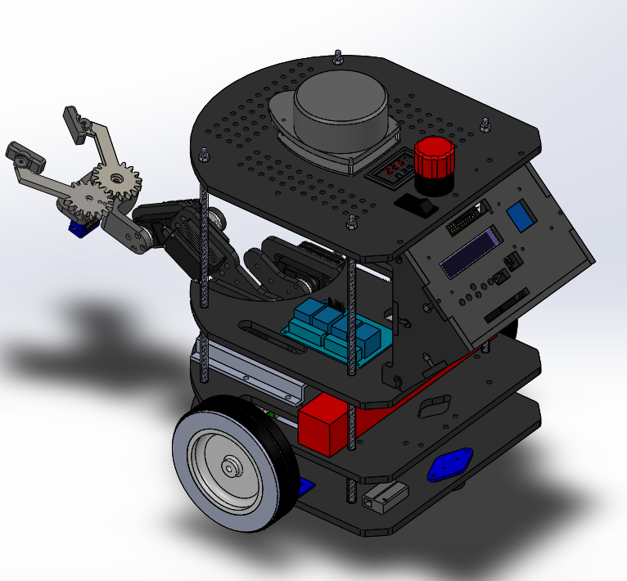
Notes:
Emphasize on the security access, why

Slide 8
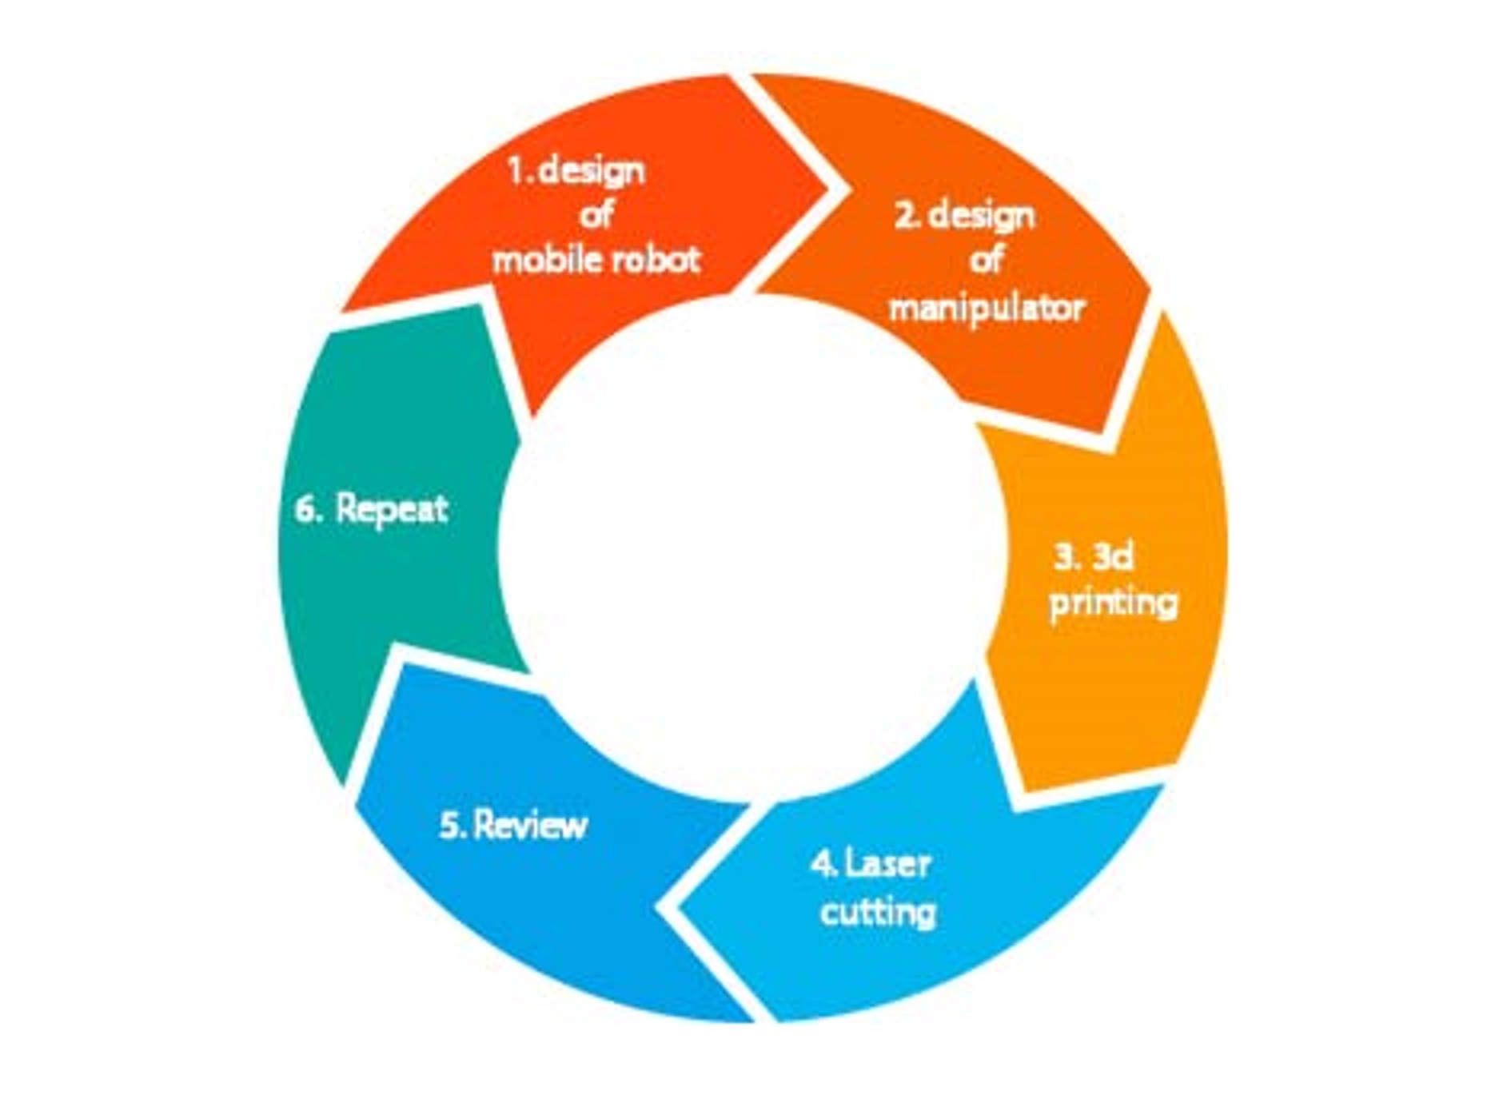
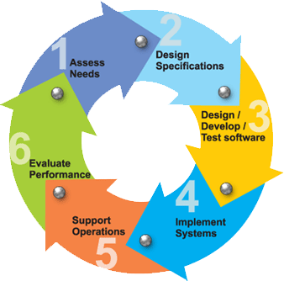


Project development
Project Goals
Battery life etc.
Testing & Validation
G.A’s & Lecturers
Notes:
Design of mobile robot
Design of manipulator
3d printing
Laser cutting
Review
Repeat

Slide 9
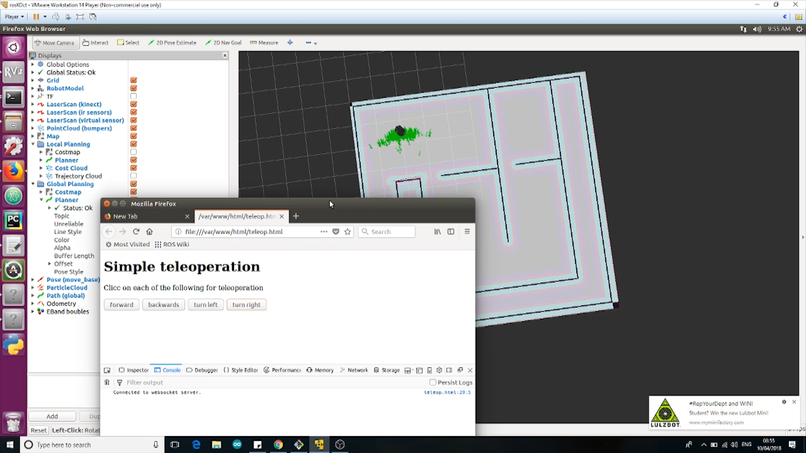
Testing and validation

Slide 10
Summary and future work
What’s next?...
Notes:
( remind the audience where the current status of the project and then talk about what to expect within the time limit

Slide 11
Thank you

